Slide 1

INSTAGRAM FAKE ID DETECTION
GROUP MEMBERS :
AMARNATH PANDA (TL)
SANCHITA SABAT
CHANDAN DANDIA

Slide 2

CONTENTS :
INTRODUCTION
FEATURES OF DATASET
EXPLORATORY ANALYSIS
BINARY FEATURES
CONTINUOUS FEATURES
FLOW CHART
HLD DIAGRAM
DFD DIAGRAM
ER DIAGRAM
LLD DIAGRAM
UML DIAGRAM
FEATURE ENGINEERING
ADVANTAGE
DISADVANTAGE
SCREEN SHOT
CONCLUSION

Slide 3
INTRODUCTION
Instagram is definitely one of the most popular social-media platforms in the world. According to the Data-reportal, by January 2023, its user base consisted of 1.318 billion people around the globe. This means that about 21% of all people above the age of 13 are on the platform.
With such a wide audience, Instagram became more than simply a photo-sharing platform. People use it for marketing, for sharing their political views, educational purposes, and to make businesses!
In this context, it isn’t hard to imagine that the presence of fake accounts and scammers would also start to grown. These profiles can be used for various malicious purposes, such as spreading misinformation, phishing, or even stealing the identity of their victims.

Slide 4
FEATURES OF DATASET
profile pic: What appears to be a binary feature indicating if an account has a profile picture or not;
num/length username: A continuous feature indicating the ratio of numerical characters to the total length of an account’s username;
Full name words: What also seems to be a continuous feature containing the total words in the name of the person who owns the account;
num/length full name: A continuous feature indicating the ratio of numerical characters to the total length of the person’s full name;
name == username: Another binary feature that indicates if the name of the person matches the username;
description length: The length of the profile description. It probably refers to the bio.
external URL: A binary feature that indicates if the profile has a link for an external website in its bio;
private: Another binary feature indicating if the profile is closed for non-followers or not;
#posts: The total amount of posts the account has;
#followers: The total amount of followers the account has;
#follows: The total amount of people the owner of the account follows;
fake: This is our target variable, the one we’d like to predict. It’s a binary feature indicating whether an account is real or fake, where 0 suggests a real account and 1 suggest a fake account

Slide 5
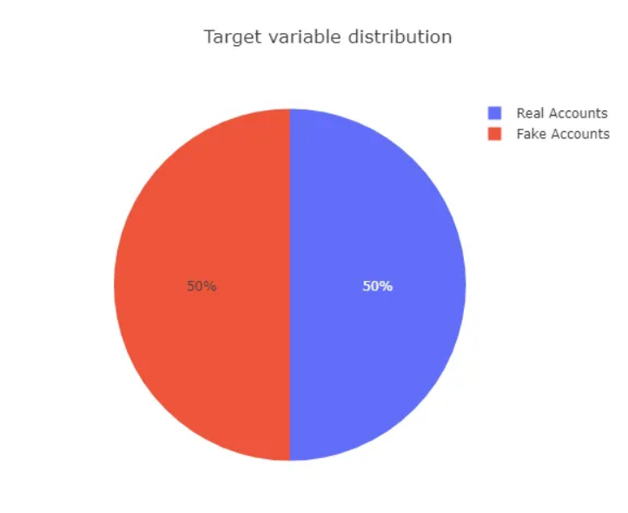
EXPLOARATORY ANALYSIS
After treating the data, we can do an exploratory data analysis by performing data visualization techniques. This allows us to identify patterns and extracts insights from the data, by observing how these features differ between real accounts and fake accounts.
To start, we should check the class balance in the target variable to determine the number of fake and real accounts in the dataset. Identifying a strong class imbalance, which isn’t uncommon, is important, as we need to address this issue early on.

Slide 6
BINARY FEATURES
“profile pic”, “name==username”, “external URL”, and “private” are the other binary features we have in our train set besides the target variable.
Let’s take a closer look at them.
Does the account provides access to an external URL?
Surprisingly, no fake account in the train set has a link to an external URL. At a first sight, I tended to believe that the external URL feature could be a relevant feature to identify fake accounts, as they could use these links to steal information from their victims. However, through this analysis, we can see that this isn’t the case, and the accounts who do have external URL links are real accounts.
Does the account’s name match the username?
Most account’s name doesn’t match the username, regardless of being real or fake. However, among the small minority that does match, most are actually fake accounts. This feature, nevertheless, may not hold much predicting power when classifying fake or real accounts. At least, that’s the very first impression we can take from it.

Slide 7
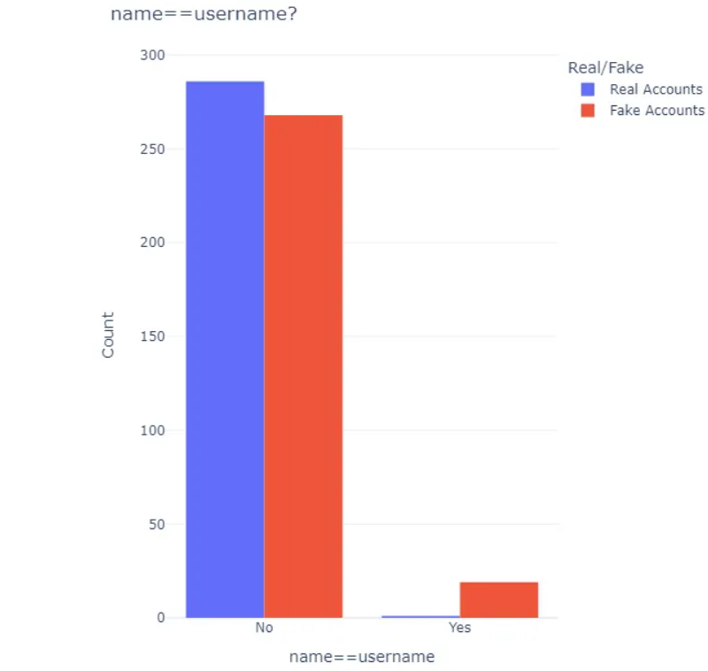
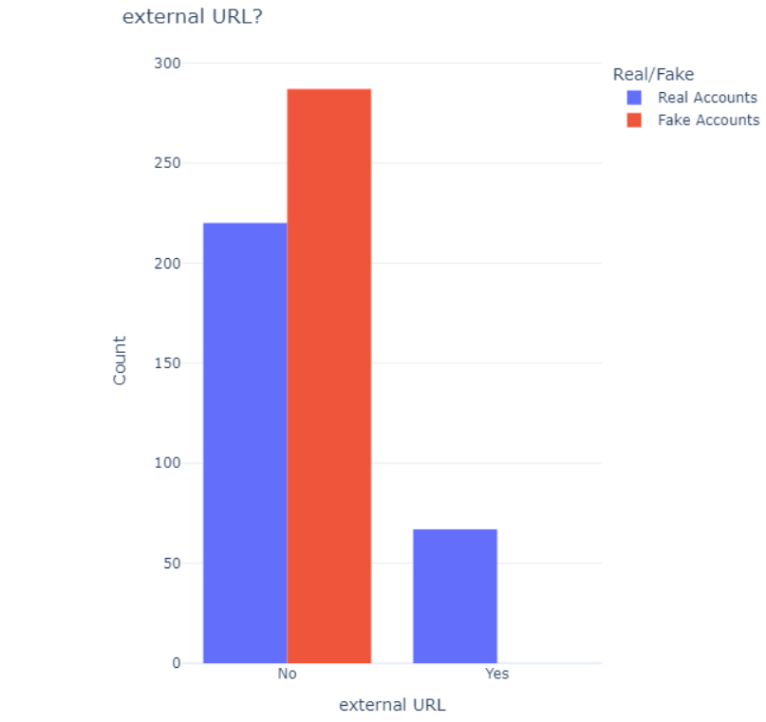

Slide 8
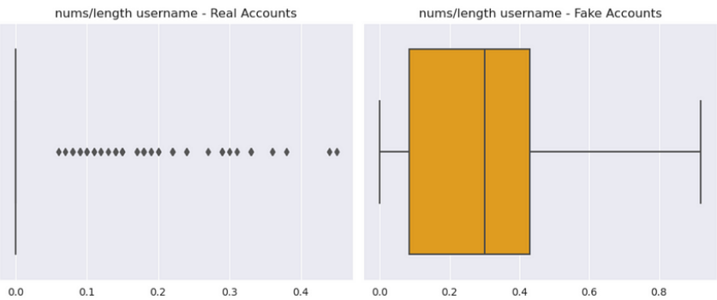
CONTINUOUS FEATURE
The continuous features in the train set are “num/length username”, “full-name words”, “num/length full name”, “description length, “#posts”, “#followers”, and “#follows”.
Some of the examples are :
Numerical chars ÷ length of the username
This feature tells us what percentage of an account’s username consists of numbers, according to its length.
Apparently , there is a much more balanced use of numerical characters in the username of fake accounts, which seems to be much more common than in real accounts.
Most real accounts don’t seem to make use of numerical characters in their username at all, except for a few outliers. This feature may also be a strong indicator for fake accounts.

Slide 9
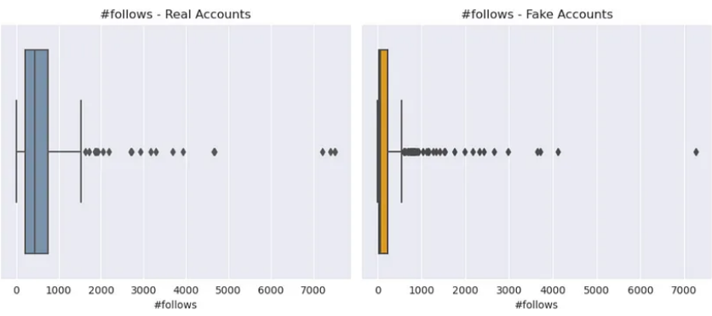
Total number of followers
The x-axis on the number of followers for real accounts have been abbreviated using scientific notation, and it seems that we could have accounts with up to 10,000,000 followers, while the maximum number of total followers of fake accounts is at around the 3,000 mark.
It doesn’t necessarily mean that real accounts may have, on average, more followers than fake accounts, however, the outliers of real accounts certainly are on a larger scale than those of the fake accounts, which could display some power to predicting the target variable.

Slide 10
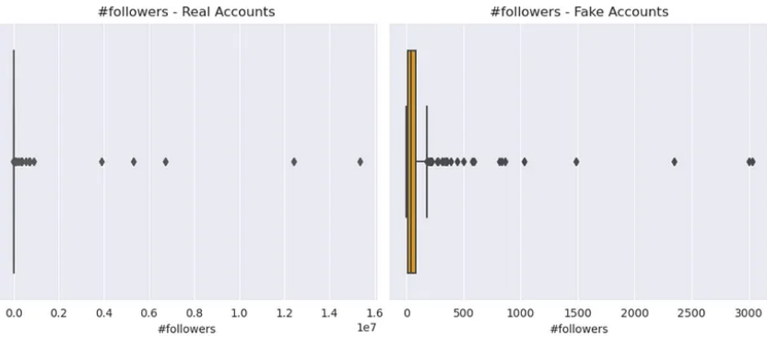
Total number of posts
Overall, both real and fake accounts don’t have an enormous amount of posts, most are below the 1,000 mark.
However, when looking at the outliers, it can be said that, overall, real accounts may have much more posts than fake accounts.

Slide 11
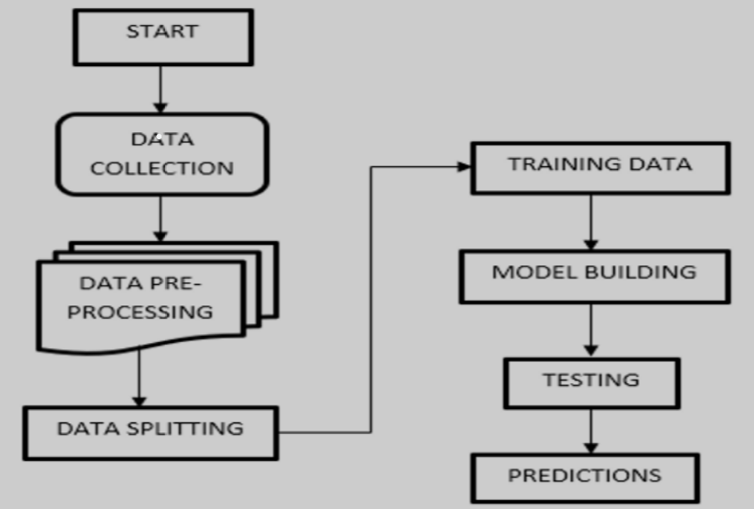
FLOWCHART

Slide 12
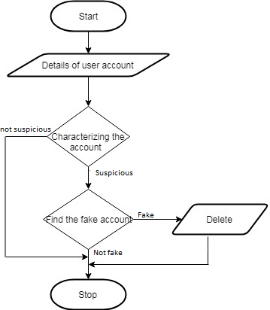
HIGH LEVEL DESIGN (HLD)

Slide 13
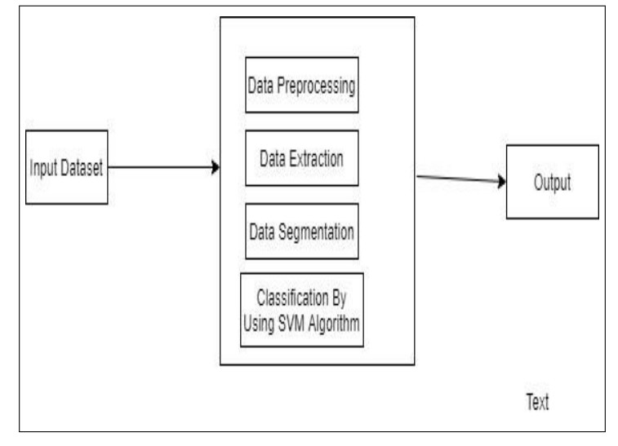
DATA FLOW DIAGRAM

Slide 14
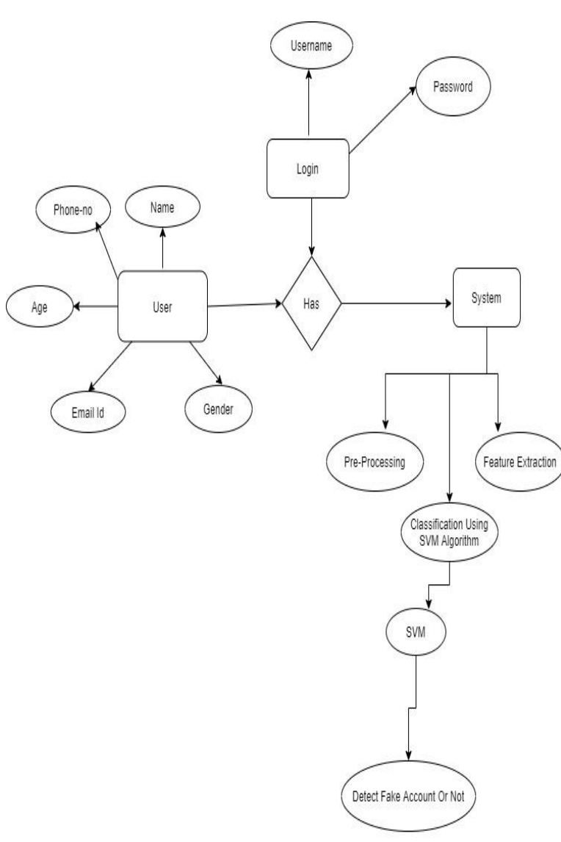
ENTITY-RELATIONSHIP (E-R) DIAGRAM

Slide 15
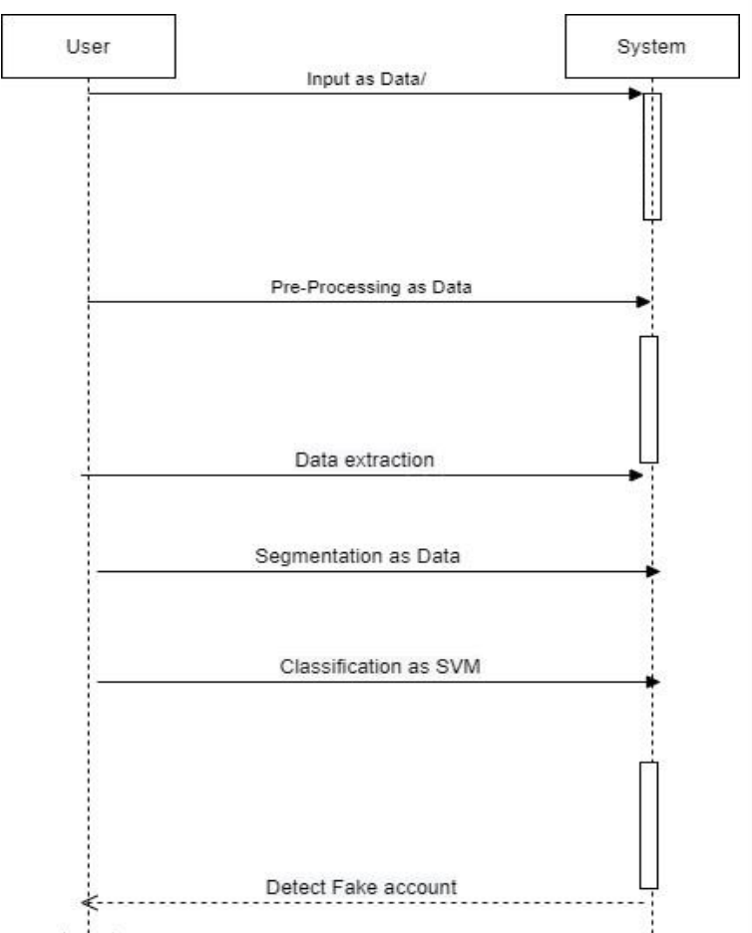
LOW LEVEL DIAGRAM (LLD)

Slide 16
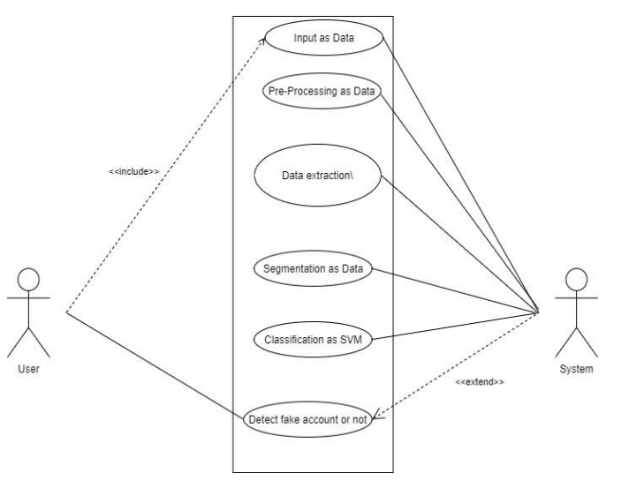
UML DIAGRAM

Slide 17
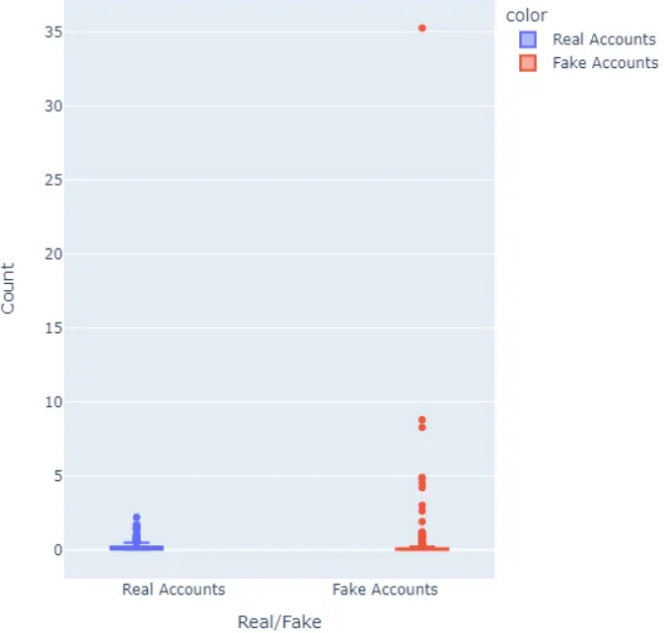
FEATURE ENGINEERING
Feature engineering is the process of creating new features based on the ones we already have in the dataset in order to convey more information and feed our models with more attributes that they can learn from and improve its overall robustness and performance.
While studying the features during the process of exploratory analysis, I’ve decided to create two new features.
These are:
Activity ratio: This is simply going to measure an account’s posting activity according to the number of followers it has.
It’s given by the following equation:
Activity ratio = number of posts ÷ number of followers

Slide 18
ADVANTAGES
Protecting Users:
Fake IDs can be used for malicious purposes such as impersonation, fraud, or harassment. Detecting
and removing them helps protect users from potential harm.
Maintaining Authenticity:
Instagram's appeal lies in its authenticity. Removing fake IDs helps maintain the integrity of the
platform and ensures that users interact with genuine accounts.
Enhancing Trust:
By actively monitoring and removing fake IDs, Instagram can build trust among its user base. Users are
more likely to engage with content and other users if they believe the platform is taking steps to
maintain its authenticity.
Preserving Brand Reputation:
For businesses and influencers, fake IDs can dilute brand reputation and credibility. Detection
measures can help protect their brand image by ensuring that followers and engagements are
genuine.

Slide 19
DISADVANTAGES
False Positives:
Automated detection systems may sometimes mistakenly identify legitimate accounts as fake ID’s
leading to account suspension or other punitive actions. This can frustrate users and damage their
trust in the platform.
Circumvention:
Sophisticated users may find ways to circumvent detection measures, leading to a cat-and-mouse
game between the platform and those attempting to deceive it. This can result in an ongoing
resource drain for Instagram.
Privacy Concerns:
Some users may feel uncomfortable with the level of security required to detect fake IDs,
especially if it involves analyzing personal information or behavior patterns. This could lead to
privacy concerns and backlash from users.
Resource Intensive:
Implementing effective fake ID detection systems requires significant resources in terms of
technology, manpower, and time. This investment may not always yield perfect results and could
divert attention and resources from other platform improvements

Slide 20
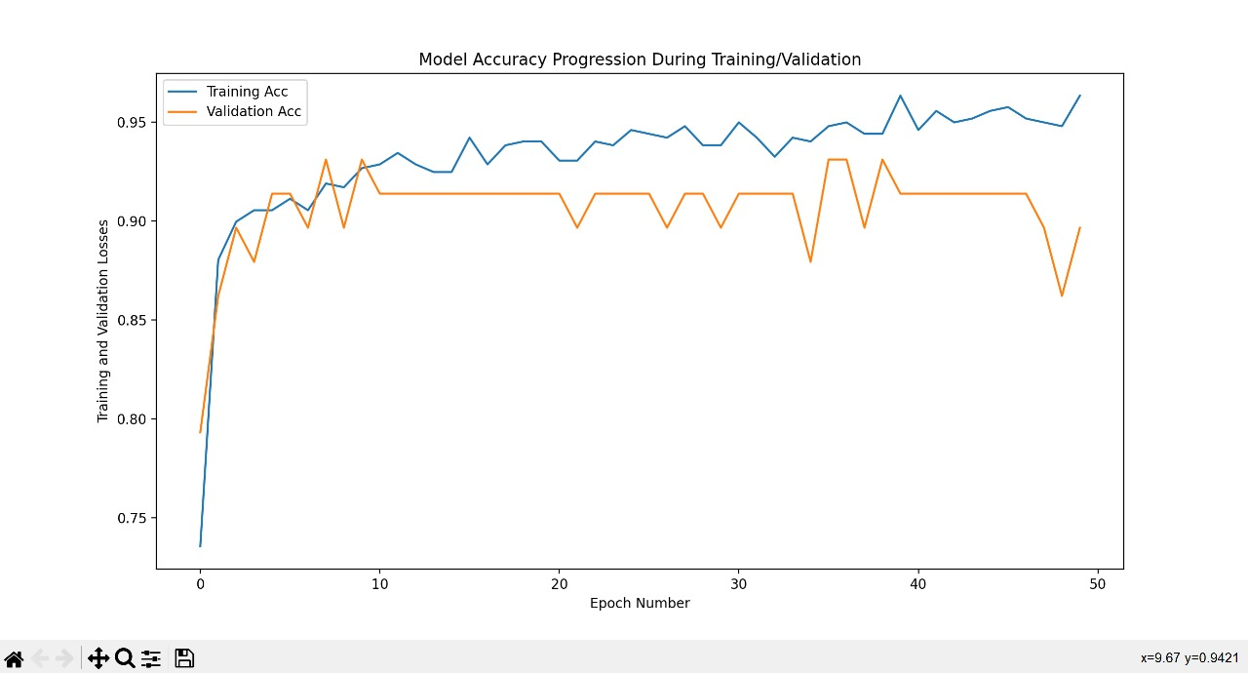
SCREEN SHOT

Slide 21
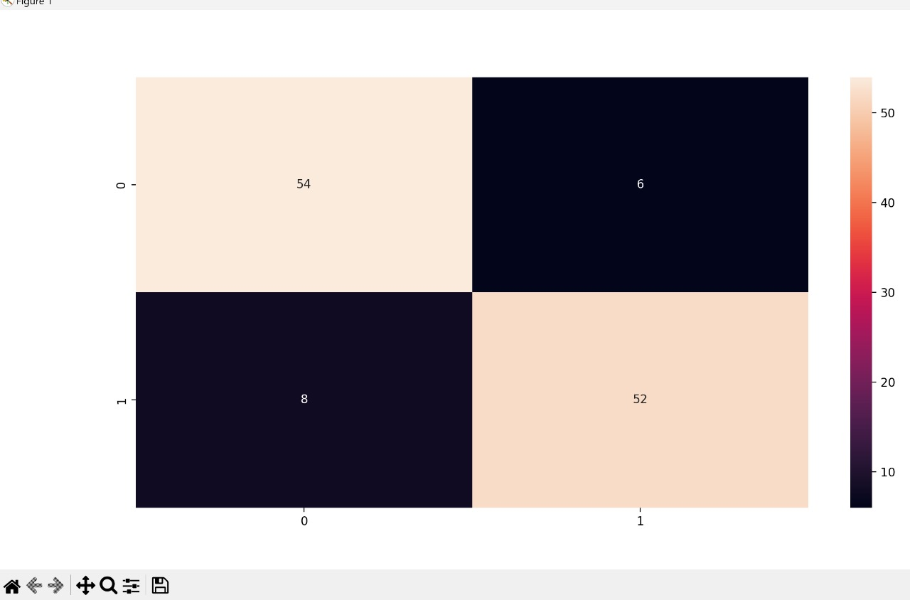
SCREEN SHOT

Slide 22
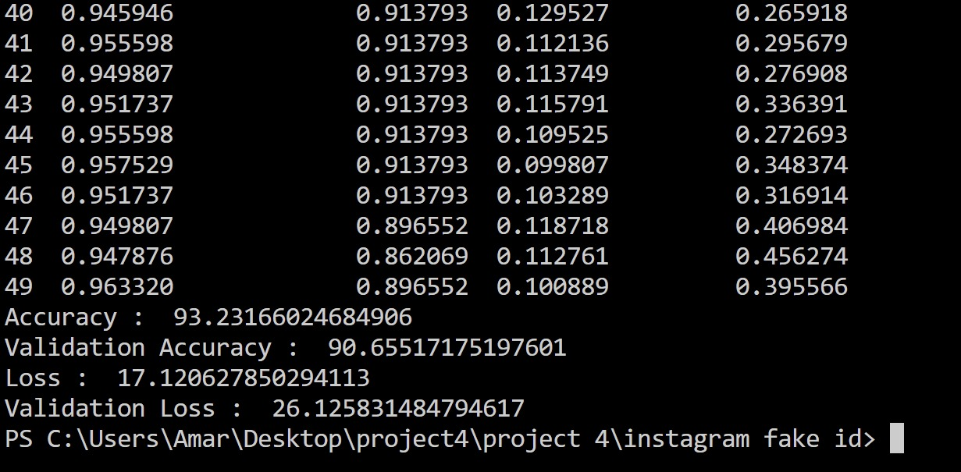
SCREEN SHOT

Slide 23
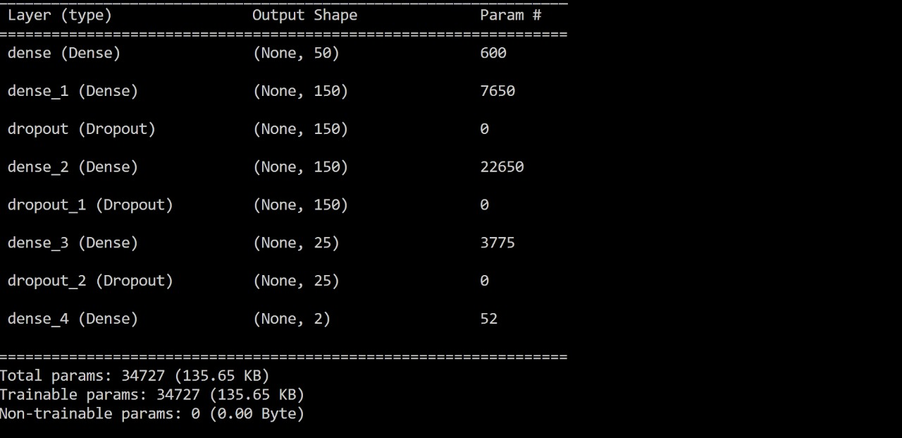
SCREEN SHOT

Slide 24
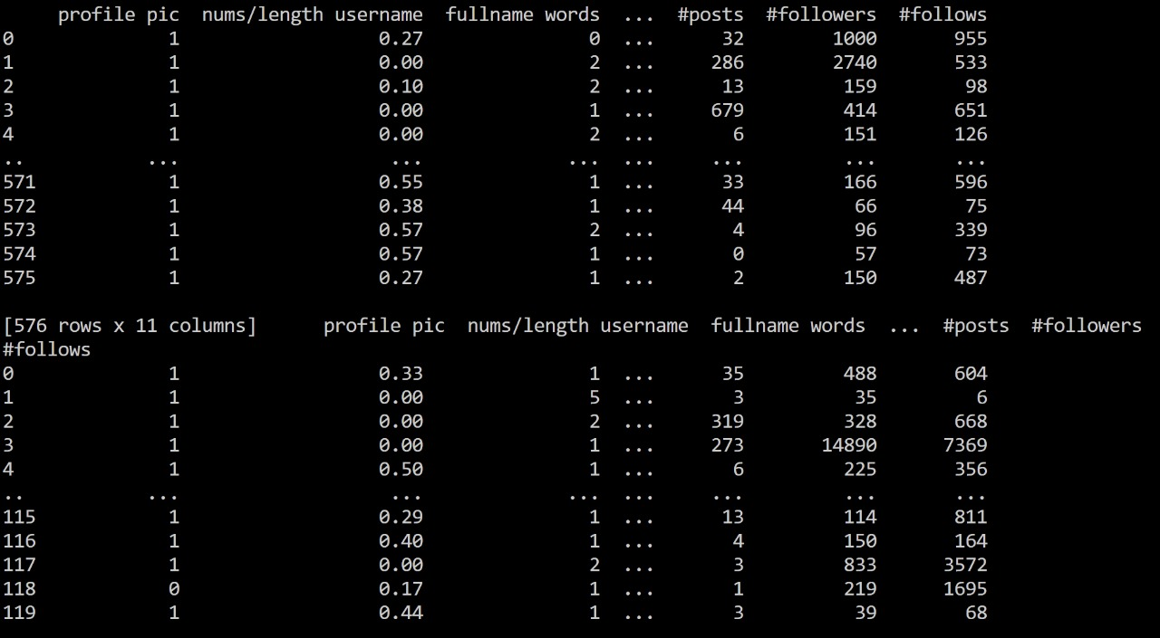
SCREEN SHOT

Slide 25
CONCLUSION
During the development of this project, we performed multiple data treatment and data analysis procedures to identify patterns and extract insights from data.
By developing a baseline model, we’ve established a benchmark to compare our final models to. That also allowed us to understand better what features displayed a high predicting importance of the target variable, which helped us to select relevant features during the feature engineering process.

Slide 26
THANK YOU !

